Slide 1
PROJECTED TEACHING AIDS
When a projected aid is used an enlarged image of the material is projected on a screen kept at a distance from the projector

Slide 2
The room is either partially or totally darkened
Color makes the aid more attractive
Motion makes the aid more dynamic
Motion associated with sound is more effective

Slide 3
Types of projected visuals
Film strips (using film strip projector)
Slides ( using slide projector)
Opaque materials ( using opaque projector)
Transparencies ( Using overhead projector)
Electronic slides ( Using LCD projector)

Slide 4
Types of Motion picture projection
35mm projection for entertainment -6 frames /foot
16mm projection for educational films - 40 frames / foot -24 frames per second
70mm projection for entertainment movies, magnetic recording with multiple sound tracks

Slide 5
Advantages of motion pictures in teaching
Action gives the impression of reality and promotes better understanding
Motion pictures compel attention and as a result help in permanent retention of observed events
Fast and slow motion can be shown to occur at normal speed making analysis and appreciation possible

Slide 6
Technical animation effectively serves to explain things which are too abstract or hidden for effective comprehension
They bring the past and the distant into the classroom
They reach a mass of audience at a low average cost

Slide 7
Steps in using an instructional film
Identify the need to use the film
Select a suitable film
Preview the film
Prepare the students
Prepare the sitting and viewing environment
Show the film
Evaluate learning

Slide 8
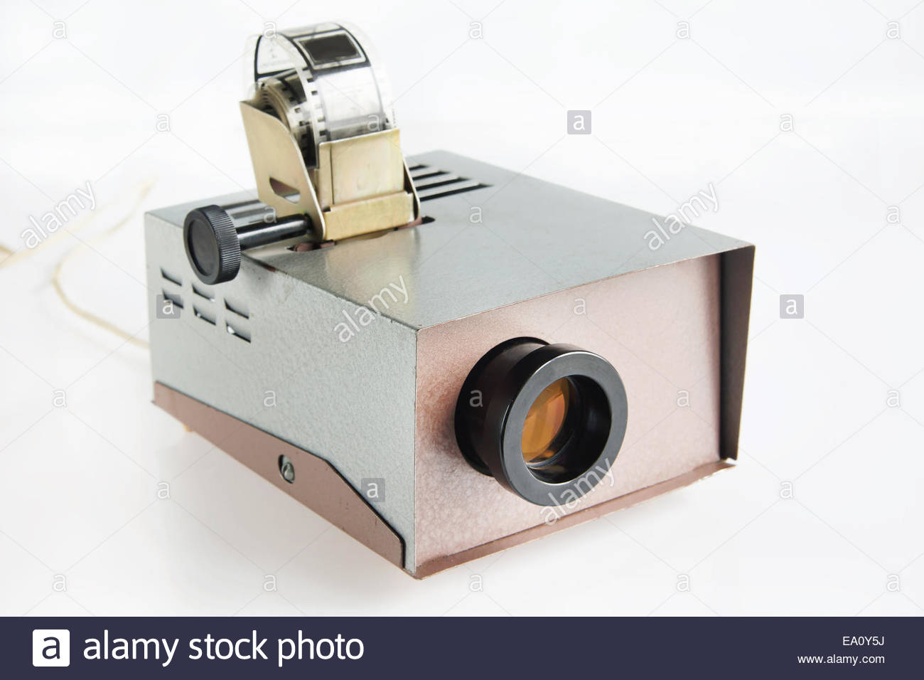
Images of projection equipment a) Film strip slide projector

Slide 9


The film strip
A film strip is a series of still pictures on one roll of film. They may tell a story or explain the steps of a process

Slide 10
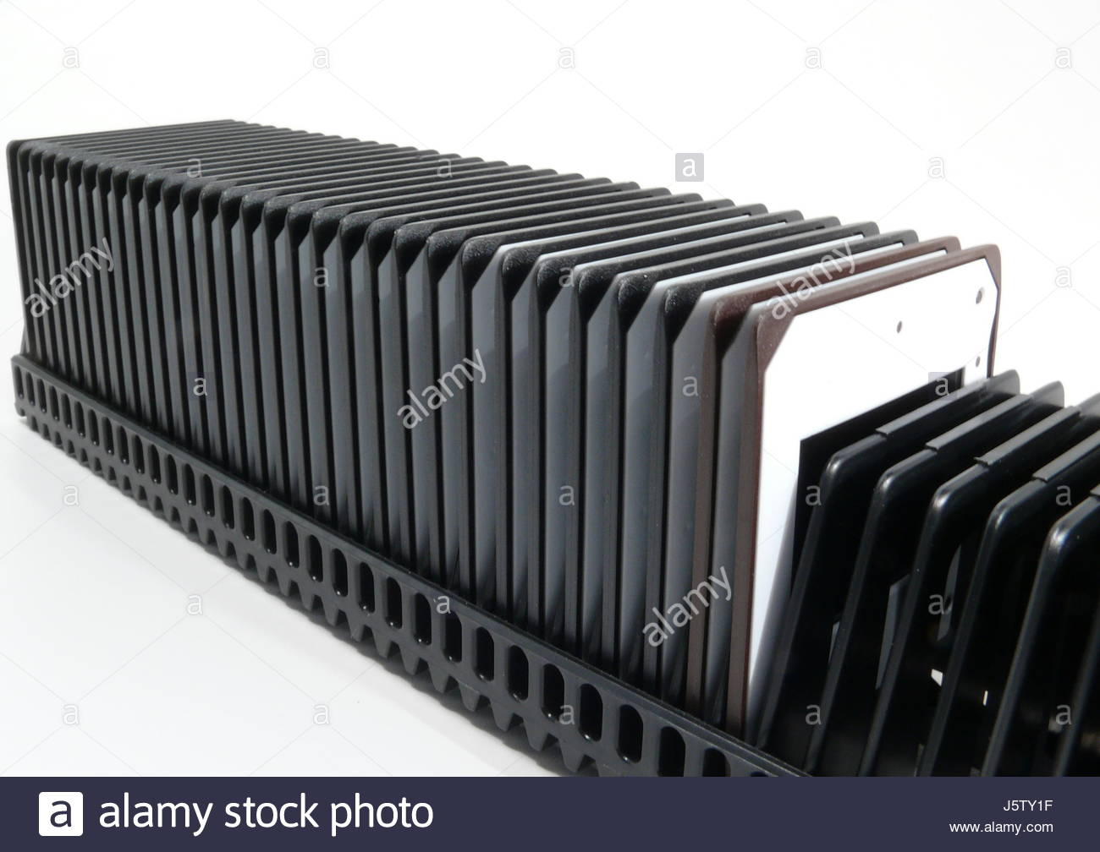
The film strip is cut to make slides from each frame. The cut frames are mounted on a card board to make slides for projection using a slide projector

Slide 11
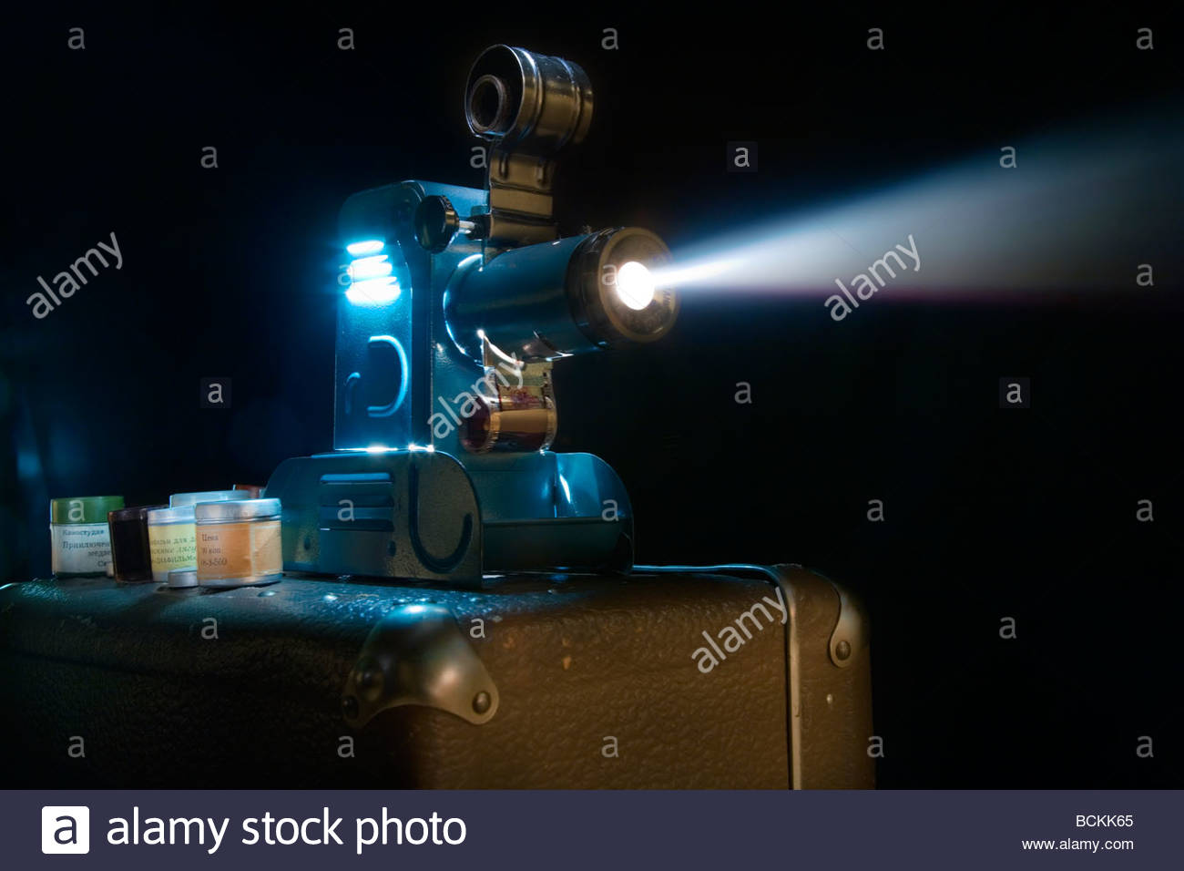
b) Film strip projector
You can hold a picture on the screen as long as you need to talk about it. Filmstrips can show a complete process, like growing rice

Slide 12
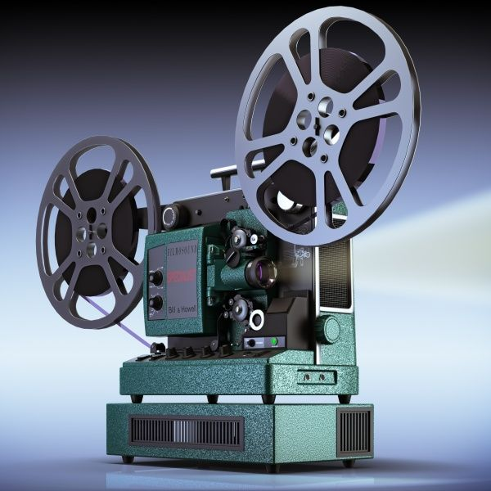
16mm film projector

Slide 13
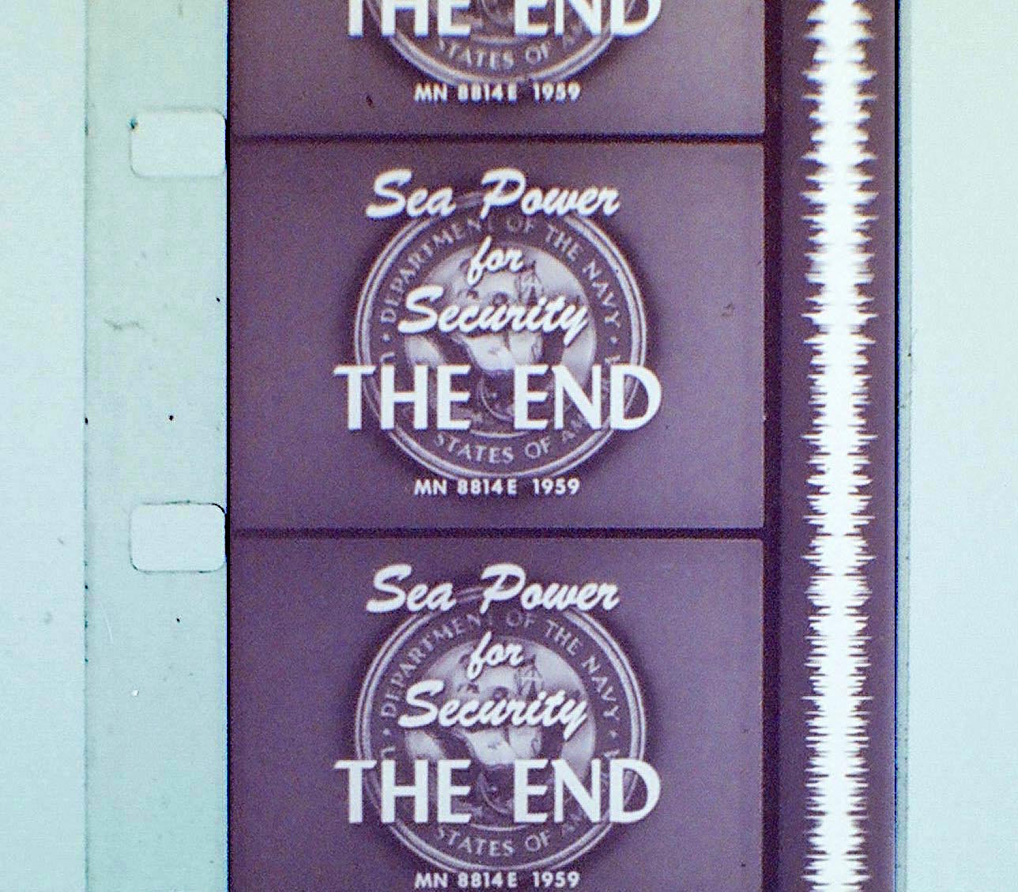
16 mm film is a historically popular and economical gauge of film. 16 mm refers to the width of the film; other common film gauges include 8 and 35 mm. It is generally used for non-theatrical film-making, or for low-budget motion pictures. It has a single sound track. Once projected, the visuals have motion and sound.

Slide 14
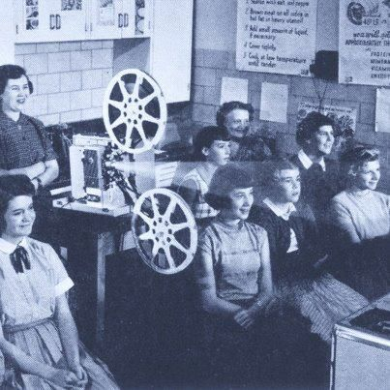
This picture shows students viewing a film projected by a 16 mm film projector

Slide 15
c) Opaque projector
The opaque projector, epidioscope, epidiascope or episcope is a device which displays opaque materials by shining a bright lamp onto the object from above. A system of mirrors, prisms and/or imaging lenses is used to focus an image of the material onto a viewing screen. Opaque projectors require brighter bulbs and larger lenses. Care must be taken that the materials are not damaged by the heat generated by the light source

Slide 16
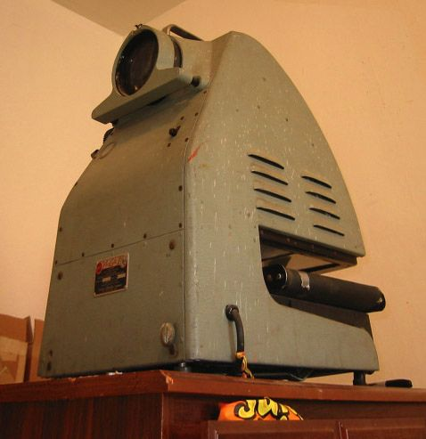
Opaque projectors are typically used to project images of book pages, drawings, mineral specimens, leaves, etc.
They have been produced and marketed as artists’ enlargement tools to allow images to be transferred
to surfaces such as prepared canvas

Slide 17
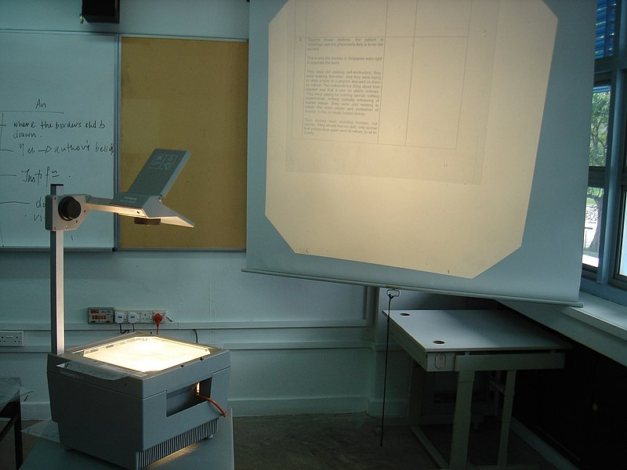
d) Overhead projector
An overhead projector (OHP), like a film or slide projector, uses light to project an enlarged image on a screen. The source of the image is a page-sized sheet of transparent plastic film (also known as 'foils') with the image to be projected either printed or hand-written/drawn. These are placed on the glass surface of the projector, which has a light source below it and a projecting mirror and lens assembly above it (hence, 'overhead')

Slide 18
e) LCD projector
An LCD (liquid-crystal display) projector is a type of video projector for displaying video, images or computer data on a screen or other flat surface. It is a modern equivalent of the slide projector or overhead projector. To display images, LCD projectors typically send light from a metal-halide lamp through a prism or series of dichroic filters that separates light to three polysilicon panels – one each for the red, green and blue components of the video signal. As polarized light passes through the panels (combination of polarizer, LCD panel and analyzer), individual pixels can be opened to allow light to pass or closed to block the light. The combination of open and closed pixels can produce a wide range of colors and shades in the projected image.

Slide 19
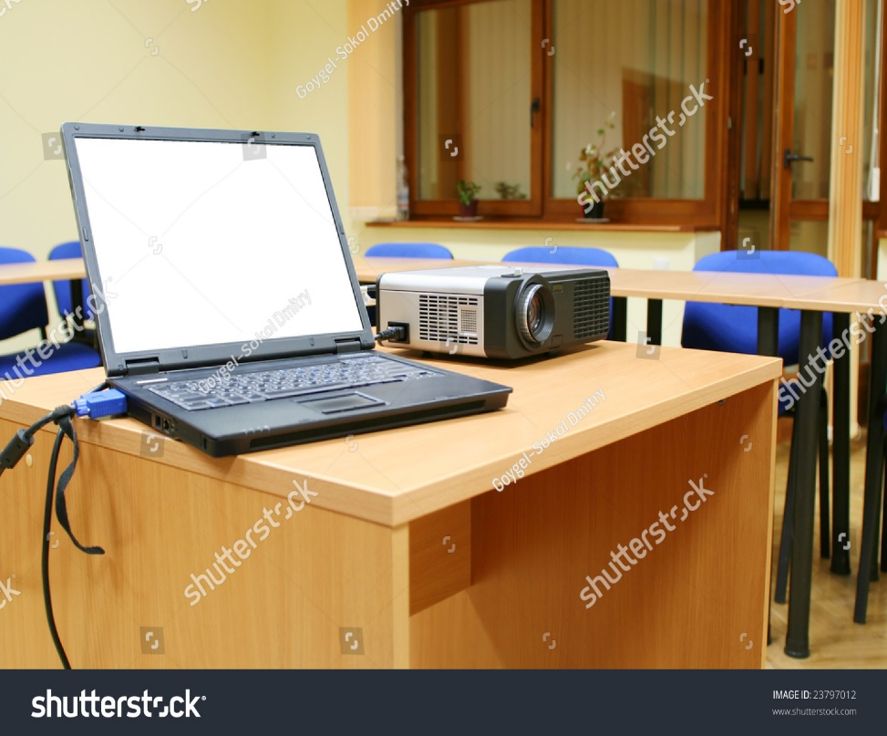
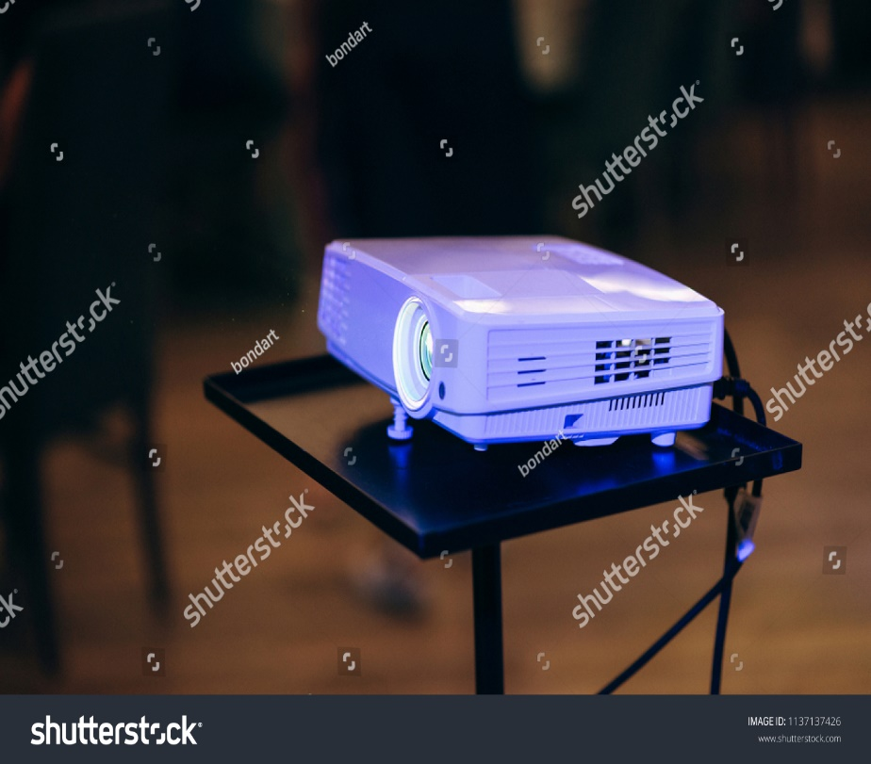
Note: You have to learn on how to connect LCD projector to the data source (e.g Laptop) and practice how to use it effectively

Slide 20
Top Ten Slide Tips
Keep it Simple
Avoid making slides that are unnecessarily complicated, busy, or full of “chart junk.” Nothing in your slide should be superfluous, ever. Your slides should have plenty of “white space” or “negative space.” The less clutter you have on your slide, the more powerful your visual message will become.

Slide 21
2. Limit bullet points & text
Your presentation is for the benefit of the audience. The slides are meant to support the narration of the speaker, not make the speaker superfluous.
Audiences are much better served receiving a detailed, written handout as a takeaway from the presentation, rather than a mere copy of your PowerPoint slides.

Slide 22
3. Limit transitions & builds (animation)
Use object builds and slide transitions judiciously
Some animation is a good thing, but stick to the most subtle and professional (similar to what you might see on the evening TV news broadcast). A simple “Wipe Left-to-Right” (from the “Animations” menu) is good for a bullet point, but a “Move” or “Fly” for example is too tedious
For transitions between slides, use no more than two-three different types of transition effects and do not place transition effects between all slides.

Slide 23
4. Use high-quality graphics
Avoid using PowerPoint Clip Art or other cartoonish line art. Again, if it is included in the software, your audience has seen it a million times before, inclusion of such clip art often undermines the professionalism of the presenter. There are exceptions, of course, and not all PowerPoint art is dreadful, but use carefully and judiciously.

Slide 24
5. Have a visual theme, but avoid using PowerPoint templates
Your audience expects a unique presentation with new (at least to them) content, otherwise why would they be attending your talk?
6. Use appropriate charts

Slide 25
7. Use color well
Colors can be divided into two general categories: Cool (such as blue and green) and Warm (such as orange and red). Cool colors work best for backgrounds as they appear to recede away from us into the background. Warm colors generally work best for objects in the foreground (such as text) because they appear to be coming at us.Most PowerPoint slide color scheme includes a blue background with yellow text. You do not need to feel compelled to use this color scheme, though you may choose to use a variation of those colors.

Slide 26
If you will be presenting in a dark room (such as a large hall), then a dark background (dark blue, grey, etc.) with white or light text will work fine. But if you plan to keep most of the lights on (which is highly advisable) then a white background with black or dark text works much better

Slide 27
8. Choose your fonts well
Use the same font set throughout your entire slide presentation, and use no more than two complementary fonts (e.g., Arial and Arial Bold).
San-serif fonts (e.g Arial ) are generally best for PowerPoint presentations, as compared to Serif font (e.g., Times New Roman)

Slide 28
9. Use video or audio
Use video and audio when appropriate. Using video clips to show concrete examples promotes active cognitive processing, which is the natural way people learn.
Avoid cheesy sound effects

Slide 29
10. Spend time in the slide sorter
According to the Segmentation Principle of multimedia learning theory, people comprehend better when information is presented in small chunks or segments.
By getting out of the Slide View and into the Slide Sorter view, you can see how the logical flow of your presentation is progressing. In this view you may decide to break up one slide into, say, two-three slides so that your presentation has a more natural and logical flow or process.

Slide 30
Read and practice on how to use PowerPoint:
How to design slides
How to use transitions
How to make animations
How to insert other media like audio and video
Qualities of good slides
How to effectively present using power point

Slide 31
Advantages of LCD projected slides over the overhead projected transparencies
Animations have a dramatic effect
Does not involve photocopying or printing process
Slides are maintained in the order they are prepared
Easy to use different schemes of color
Pictures are easily incorporated
6. Easy to modify as they are in electronic form
7. Storage is easy

Slide 32
Advantages of overhead projector over LCD projected slides
The cost of the projector is lower compared to LCD projector and lap top
The skill involved in the use of the overhead projector is not as intricate
The set up is simple
The transparency master once prepared can not be corrupted with viruses

